Slide 1




Approximation Algorithm on Texture Packing
——Group 2：林子昕、胡凯淳、吴梓聪

Slide 2




CONTENTS
Introduction
Algorithm
Test
Conclusion
- random width and height
- Square sequence
- Literature-offered
- tetrominos
- approximate radio
- time complexity

Slide 3

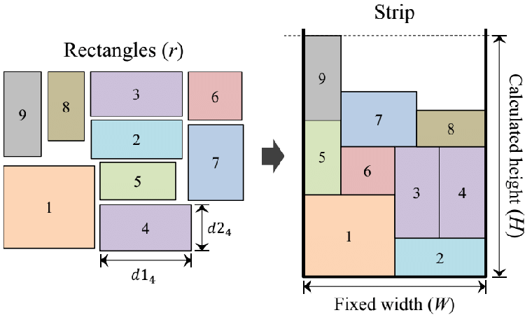
Introduction
Algorithm
Test
Conclusion
Texture Packing
Texture packing is to arrange the given textures within a large texture of specified width while minimizing the height required, which is known to be NP-hard.
In this project, the focus is on designing an approximation algorithm that runs in polynomial time.
Relationship between bin packing and texture packing
It is well known that strip packing is a generalization of bin packing. Namely if we restrict all input rectangles to be of the same height, then strip packing is equivalent to bin packing.
Notes:
Strip packing problem 其实就是把给定的一组轴对齐的矩形放进一条宽度有限但高度无限的 Strip 里面，在确保矩形之间不重叠的情况下，需要使得Strp的高度尽量小。
实际上Strip packing problem 是上课时所讲的 bin packing的推广形式，如果我们将所有输入的矩形限制为相同的高度，那么Strip packing problem就等同于 bin packing problem。

Slide 4
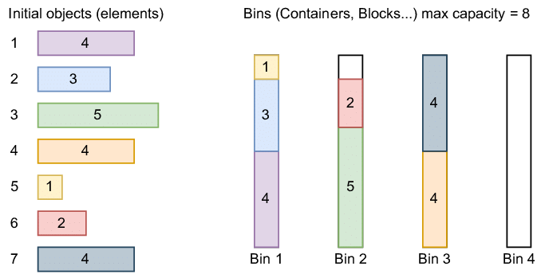
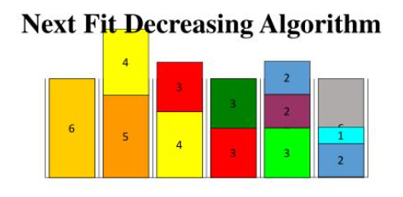
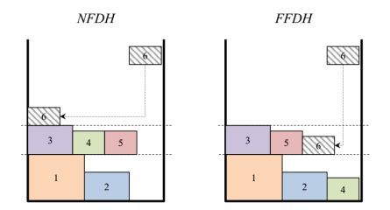
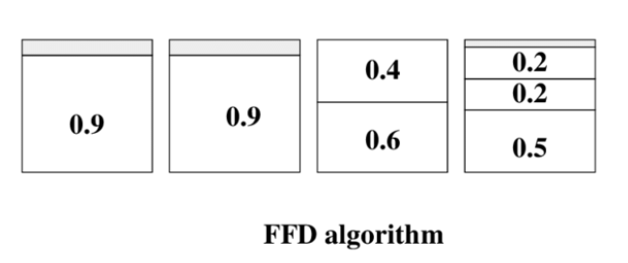
Introduction
Algorithm
Test
Conclusion
bin packing texture packing
the same height
Next Fit
NFDH
First Fit
FFDH
Notes:
因此，类比bin packing的NFD和FFD算法，我们很自然地得到了strip packing的NFDH和FFDH算法

Slide 5
CONTENT
Introduction
Algorithm
Test
Conclusion
- approximate radio
- time complexity
- random width and height
- Square sequence
- Literature-offered
- tetrominos

Slide 6
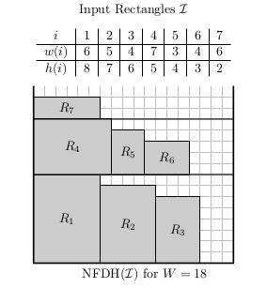
Introduction
Algorithm
Test
Conclusion
Next Fit Decreasing Height (NFDH)
this algorithm first sorts the items by order of nonincreasing height. Then, starting at position (0,0), the algorithm places the items next to each other in the strip until the next item will overlap the right border of the strip. At this point, the algorithm defines a new level at the top of the tallest item in the current level and places the items next to each other in this new level.
Approximation ratio：
NFDH(I) ≤ 2 OPT(I) + h_{max} ≤ 3 OPT(I)
For every ε> 0, there exists a sample NFDH(I) > (2-ε)OPT(I)
Time Complexity：
sort：O(nlogn)
place：O(n)
Notes:
首先，我们按高度递减对矩形排序。然后，按照左对齐的方式在当前层级上进行装箱，直到右侧没有足够的空间容纳下一个矩形，我们就开启一个新的层级。对应到bin packing problem，其实就类似在当前的bin装不下了的时候，我们就装下一个bin。（这里的level可以类比bin）不考虑排序它的时间复杂度是O（n）

Slide 7
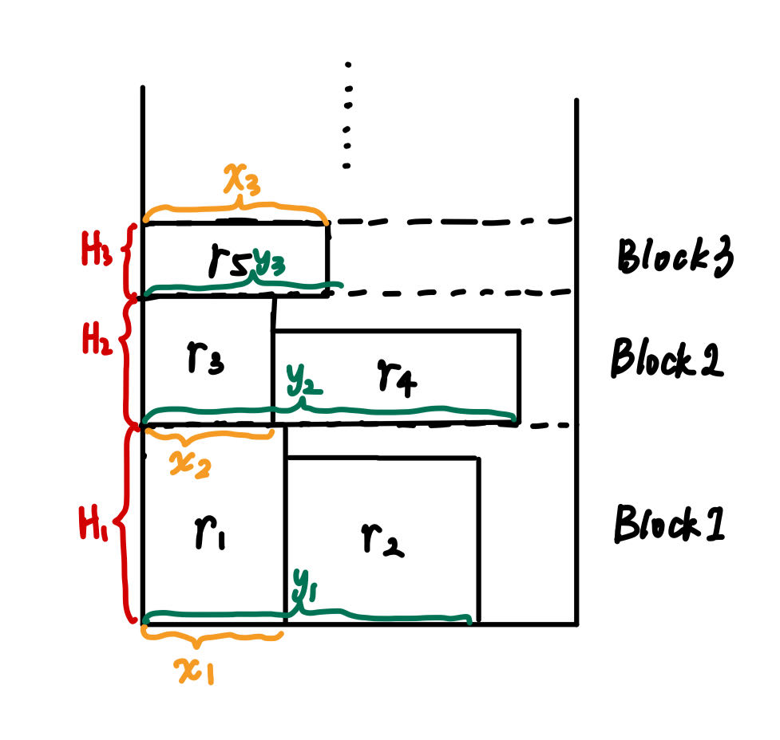
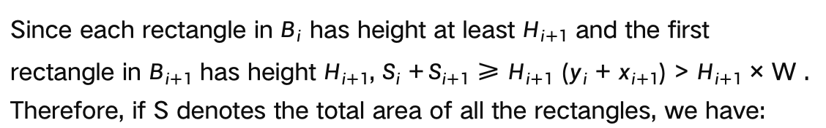
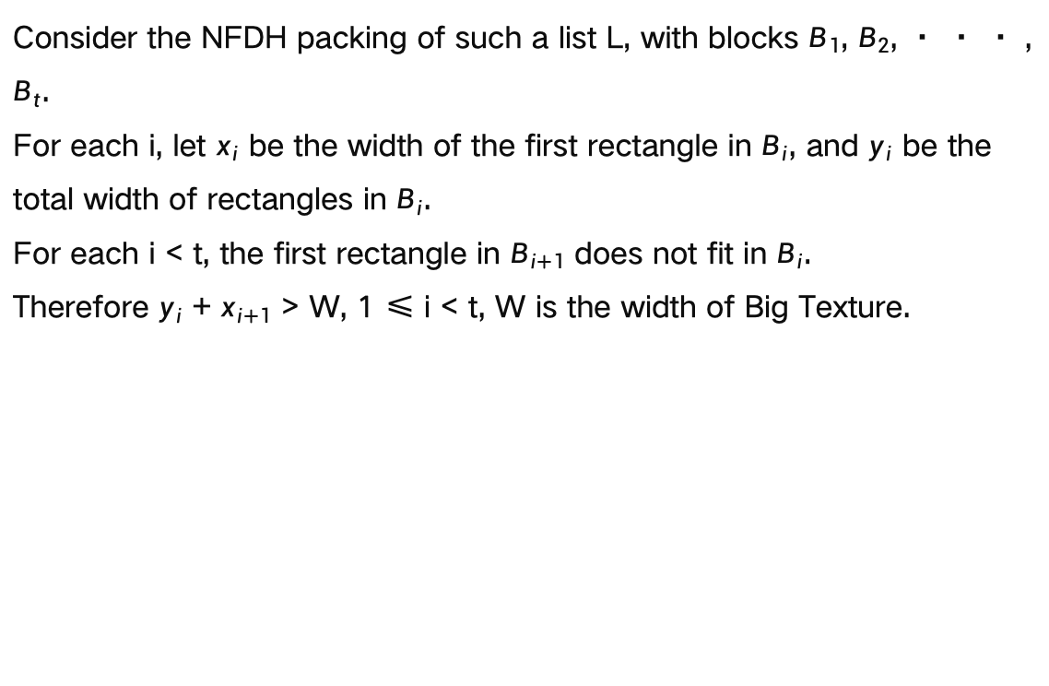
Introduction
Algorithm
Test
Conclusion
Prove the approximation ratio of NFDH
Consider the NFDH packing of such a list L, with blocks $B_{1}$, $B_{2}$, · · · , $B_{t}$.
For each i, let $x_{i}$ be the width of the first rectangle in $B_{i}$, and $y_{i}$ be the total width of rectangles in $B_{i}$.
For each i < t, the first rectangle in $B_{i+1}$ does not fit in $B_{i}$.
Therefore $y_{i}$ + $x_{i+1}$ > W, 1 ≤ i < t, W is the width of Big Texture.
Since each rectangle in $B_{i}$ has height at least $H_{i+1}$ and the first rectangle in $B_{i+1}$ has height $H_{i+1}$, $S_{i}$ +${ S}_{i+1}$ ≥ $H_{i+1}$ ($y_{i}$ + $x_{i+1}$) > $H_{i+1}$ × W . Therefore, if S denotes the total area of all the rectangles, we have:
Notes:
然后和bin packing类似的，我们也可以证明他的近似率。我们设每一层是block i，每一层的第一个矩形的宽度是xi，每一层放置的矩形的总宽度是yi，那我们可以得到xi+1+yi是大于strip宽度W的。
设Ai表示第i层所放置的矩形的总面积，我们可以得到Ai+Ai+1>Hi+1（yi+xi+1)，最后计算将每层的高度相加，得到总高度，可以算出是小于等于H1+2*A/W，A是所有矩形的总面积。A/W是OPT的下限，所以最后我们得到NFDH小于等于hmax+2OPT，小于等于3OPT.

Slide 8
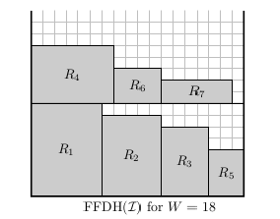
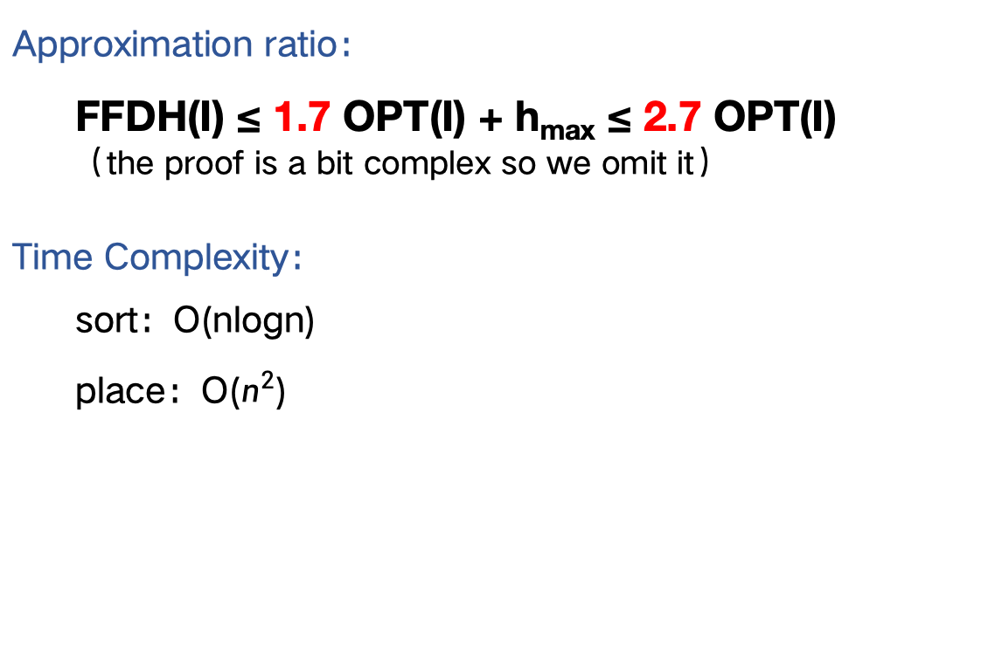
Introduction
Algorithm
Test
Conclusion
First Fit Decreasing Height (FFDH)
This algorithm works similar to the NFDH algorithm. However, when placing the next item, the algorithm scans the levels from bottom to top and places the item in the first level on which it will fit. A new level is only opened if the item does not fit in any previous ones.
Approximation ratio：
FFDH(I) ≤ 1.7 OPT(I) + h_{max} ≤ 2.7 OPT(I)
（the proof is a bit complex so we omit it）
Time Complexity：
sort：O(nlogn)
place：O($n^{2}$)
Notes:
FFDH和NFDH类似，区别就是在放置下一个物品的时候它会先去看前面的几层中还有没有位置可以放，它是近似率是…… 证明比较复杂所以我们省略。不考虑排序它的时间复杂度是O（n^2）

Slide 9
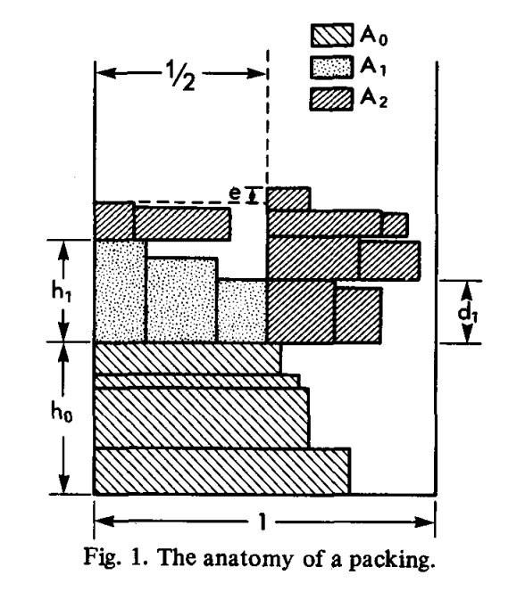
Introduction
Algorithm
Test
Conclusion
Sleator
1. Stack the rectangles that are half the width of the bottom of the container
2. Sort the remaining parts in descending order of height from left to right until they cannot be stacked below.
3. Placing from Left to RIght. Draw a vertical line that cuts the bin into two equal halves. (Notice that there may be one piece which is partly in Left and partly in Right)
4. Choose the half whose baseline is lower, placing from Left to Right
5. Repeat 4
Time Complexity：
sort：O(nlogn)
place：O(n)
Approximation ratio：
Sleator(I) ≤ 1.5 OPT(I) + h_{max} ≤ 2.5 OPT(I)
Notes:
BL是一个新的算法，它的思想很简单，就是尽可能把物品放在最下面最左边的位置。对于一系列矩形物品，该算法会先寻找每个物品可以放置的最底部位置，然后尽可能将其向左移动。但在实现过程中，由于我们要逐一判断是否重叠，所以它的时间复杂度为O(n^3)

Slide 10
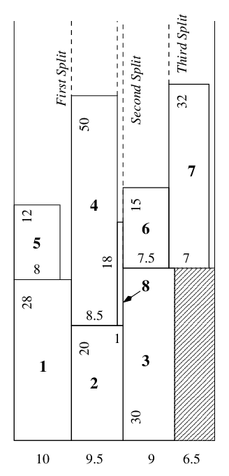
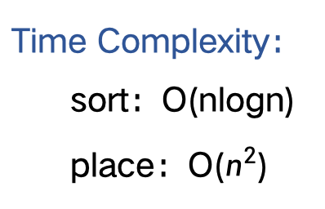
Introduction
Algorithm
Test
Conclusion
Split Packing (SP)
This algorithm places the items in decreasing order of width. The intuitive idea is to split the strip into sub-strips while placing some items. Whenever possible, the algorithm places the current item i side-by-side of an already placed item j.
In this case, it splits the corresponding sub-strip into two pieces: one containing the first item j and the other containing the current item i.
If this is not possible, it places i on top of an already placed item and does not split the sub-strip.
Approximation ratio：
SP(I) ≤ 2 OPT(I) + h_{max} ≤ 3 OPT(I)
（the proof is a bit complex so we omit it）
Time Complexity：
sort：O(nlogn)
place：O($n^{2}$)
Notes:
SP的直观思想是在放置物品时将条带分割为子条带，尽可能将当前item i与已放置的item j并排放置，然后就有了下一个子条带的分隔。如果无法实现并排放置，它将item i 放在已放置物品的顶部，而不进行子条带的分割，可以看到它的近似率也是不超过3。时间复杂度为O（n^2）

Slide 11
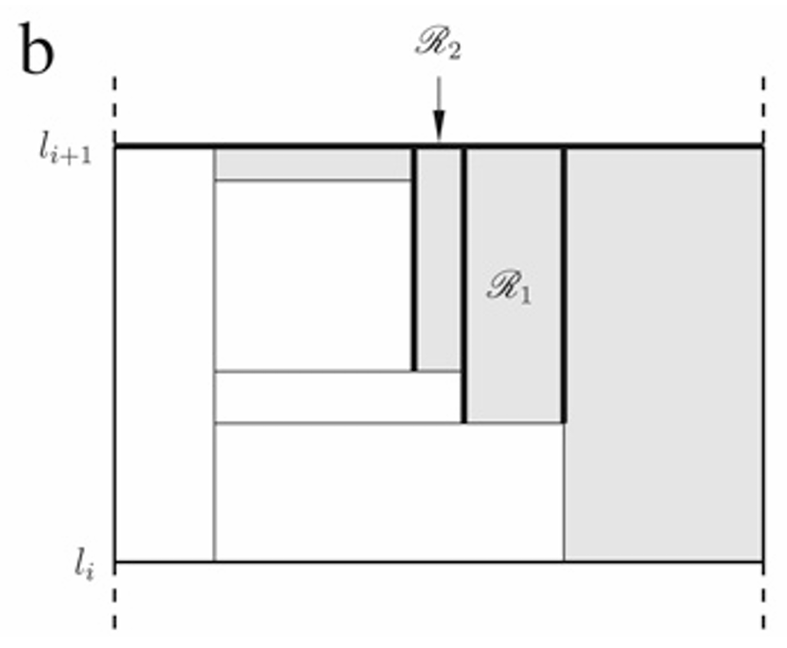
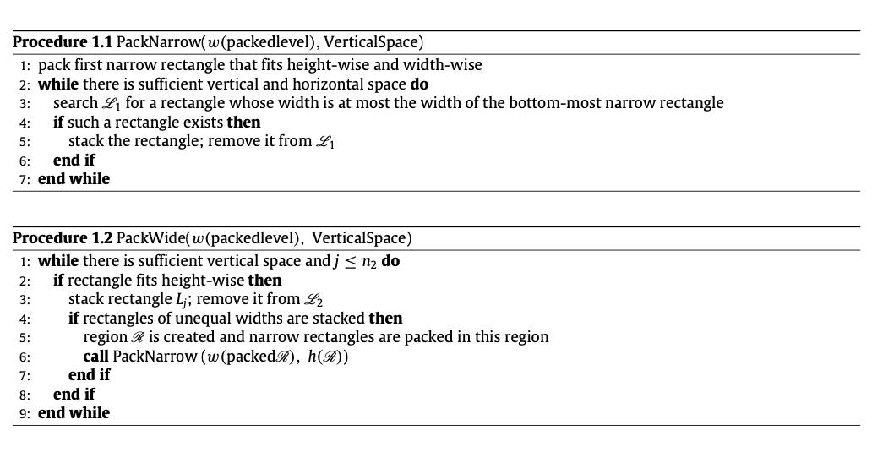
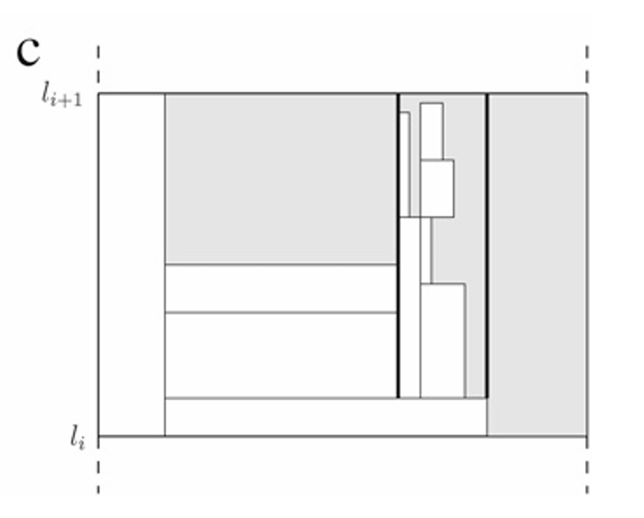
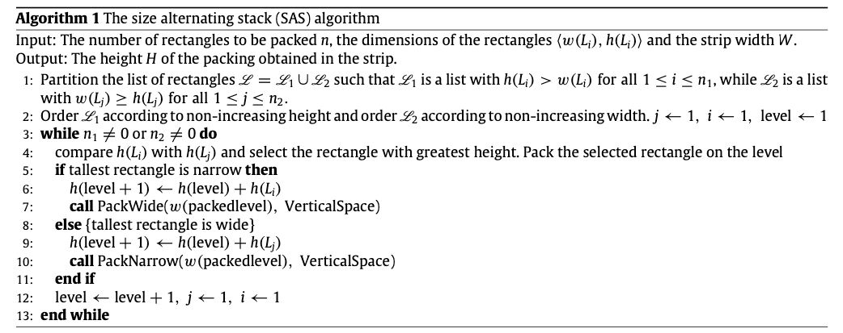
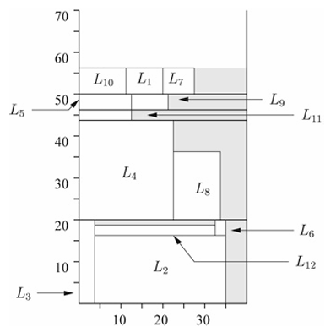
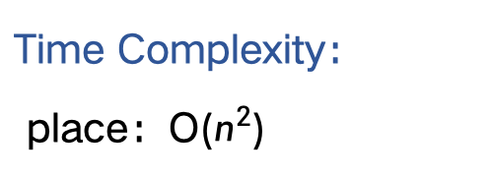
Introduction
Algorithm
Test
Conclusion
Time Complexity：
place：O($n^{2}$)
Size Alternating Stack (SAS)
1. Divide rectangles into narrow rectangles (width<height) and wide rectangles (width ≥ height), and then narrow rectangles are sorted in descending order of height and wide rectangles are sorted in descending order of width.
2. Choose the higher one in highest narrow and widest wide, Initialize this Level
3. If Init with Narrow, PackWide; If Init with Wide, PackNarrow

Slide 12
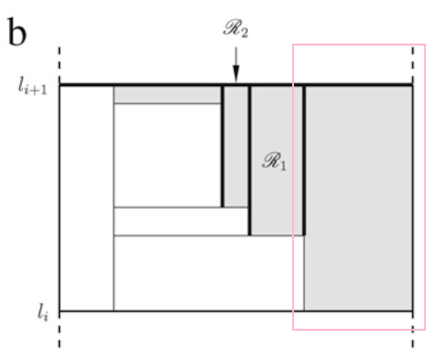
Introduction
Algorithm
Test
Conclusion
Size Alternating Stack (SAS)
DrawBack：What if the width is far more bigger than the rectangles’widths?
Approximation ratio：
？？？？？？
Welcome to the dumb corner :)

Slide 13
Introduction
Algorithm
Test
Conclusion
Advanced Size Alternating Stack (ad_SAS)
However, when the container width is much larger than the width of the rectangles, SAS algorithm performs poorly. Therefore, we optimized this algorithm and designed ad_SAS algorithm.
Approximation ratio：
？？？？？？
Time Complexity：
sort：O(nlogn)
place：O(n)
Notes:
SP的直观思想是在放置物品时将条带分割为子条带，尽可能将当前item i与已放置的item j并排放置，然后就有了下一个子条带的分隔。如果无法实现并排放置，它将item i 放在已放置物品的顶部，而不进行子条带的分割，可以看到它的近似率也是不超过3。时间复杂度为O（n^2）

Slide 14
CONTENT
Introduction
Algorithm
Test
Conclusion
- approximate radio
- time complexity
- random width and height
- Square sequence
- Literature-offered
- tetrominos

Slide 15
Introduction
Algorithm
Test
Conclusion
Visualization

Slide 16
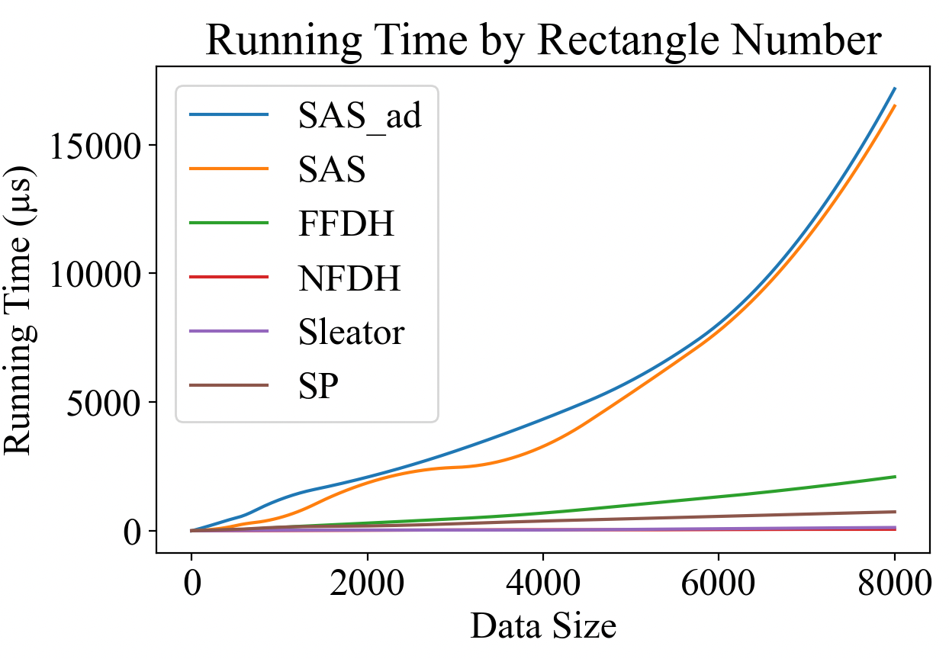
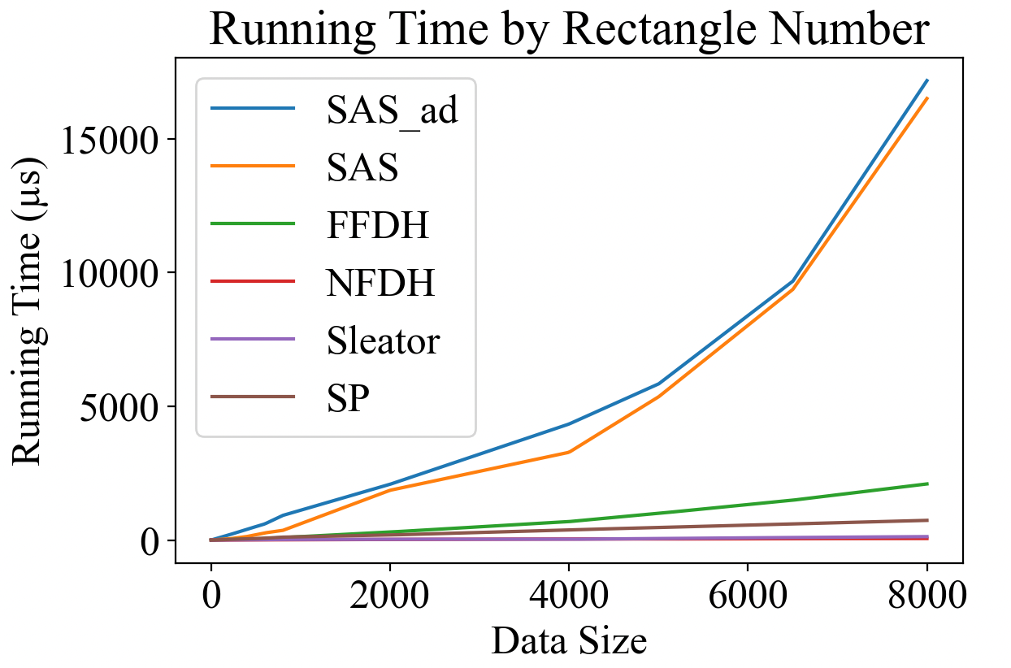
Introduction
Algorithm
Test
Conclusion
running time

Slide 17
Introduction
Algorithm
Test
Conclusion
Width factors
(by max(widths)/strip_width)
Approximation Ratio
The BL and FFDH algorithms perform the best, maintaining low and less fluctuating approximation ratios. The NFDH and Sleator algorithms perform poorly at higher width factors but improve as the width factor decreases. The SP algorithm shows consistent performance but with a declining performance as the width factor decreases.

Slide 18
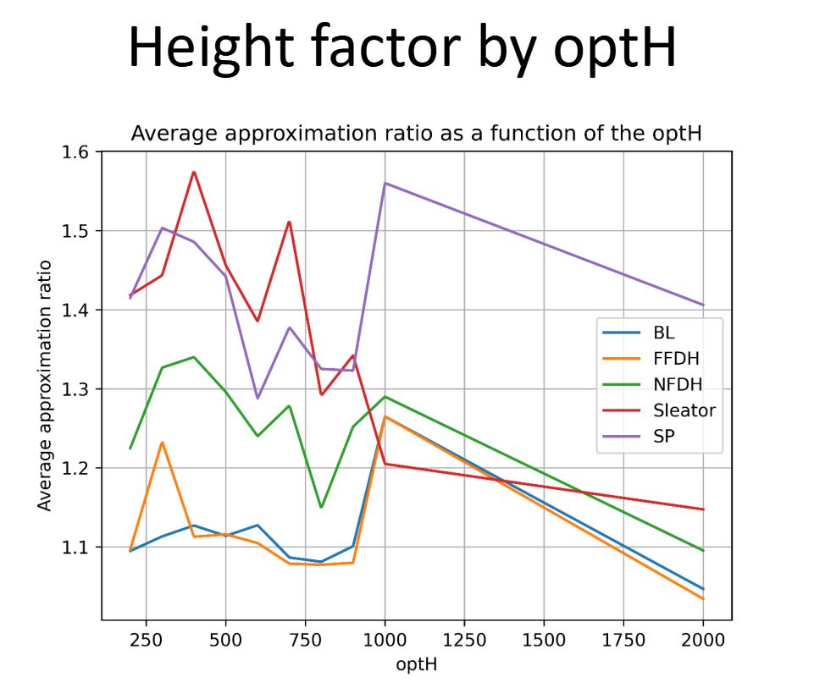
Introduction
Algorithm
Test
Conclusion
Height factors (optimal-cuts)
optimal-cuts：know the precise optH
With the increasing of optH(in other words, the numbers of rectangles), all algorithms’ approximation ratios has a declining trend
Approximation ratio: This indicates that all algorithms have similar accuracy levels, with Sleator and SP potentially offering slightly less precise results.
All algorithms offer comparable levels of accuracy as optH changes.

Slide 19
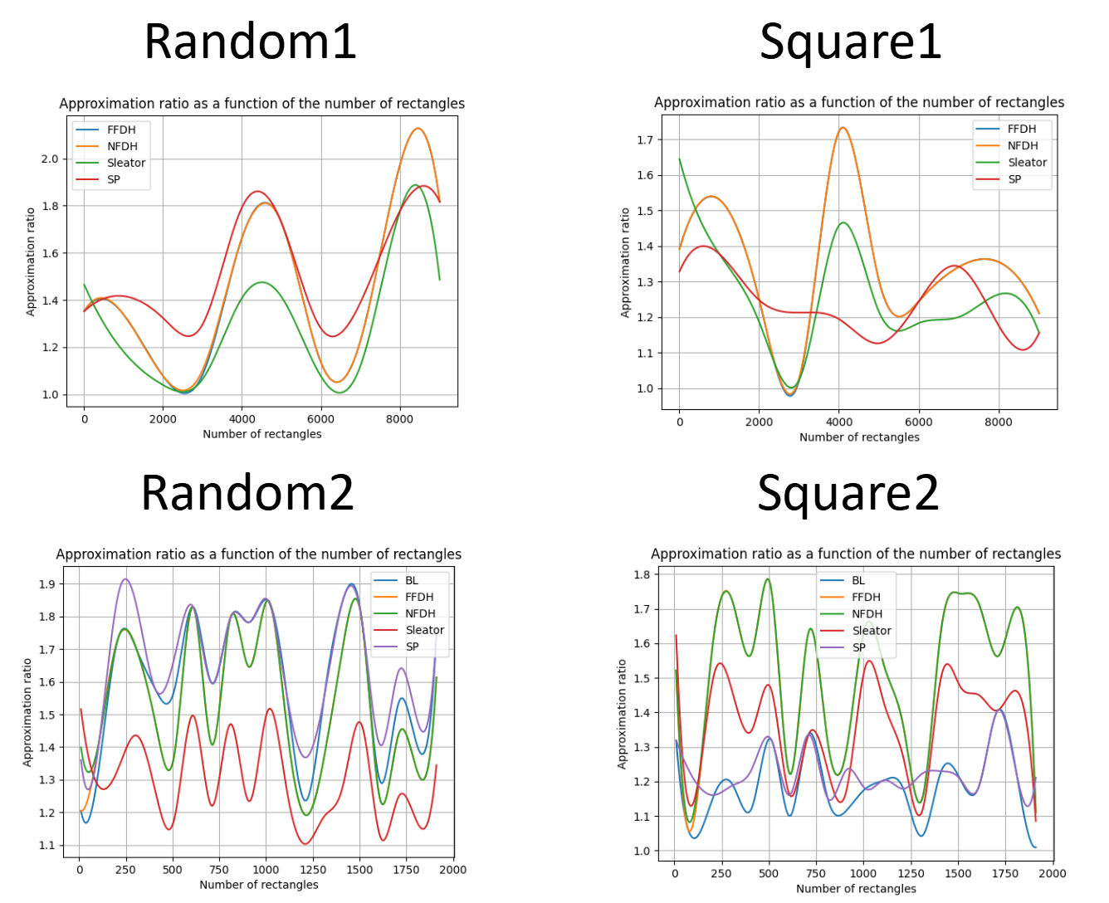
Introduction
Algorithm
Test
Conclusion
Random and square sequences
Random: It appears that the Sleator algorithm generally performs better in terms of packing efficiency.
Square: In this case, BL algorithm again performs best, as it did in other datasets.
What is worth mentioning, random tests dosen’t provide referable comparsions, just showing that every algorithm has its approximate ratio within a good range of 1~2.

Slide 20
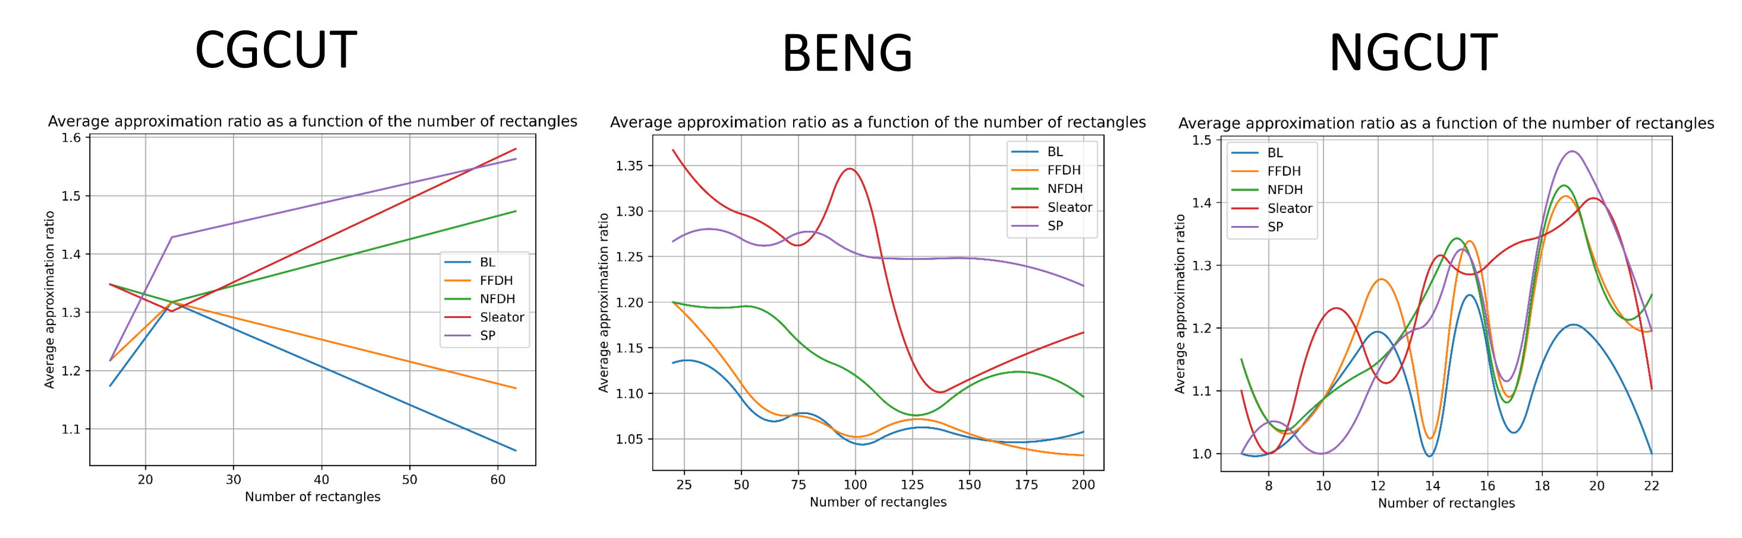
Introduction
Algorithm
Test
Conclusion
Literally offered
To better analyse their performances, we introduced some data-sets offered in previous papers, each of them provided with optimals.
The BL, FFDH, and NFDH algorithms show a decrease in approximation ratio as the dataset grows larger. Sleator's algorithm exhibits a relatively higher approximation ratio.
The SP algorithm exhibits a relatively stable approximation ratio as the dataset grows larger.
(CGCUT) Christofides and Whitlock (1977): Their approach begins with an initial rectangle
of area A0. Further rectangles are then created by generating areas Ai from a uniform distribution
in the range (0, A0/4). The height hi of each rectangle is an integer drawn from a uniform
distribution in the range (0, A0) and rounded upwards, while the width wi is calculated as the
ceiling of Ai/hi.
(BENG) Bengtsson (1982): In Bengtsson’s methodology, the lengths and widths of the rect_x0002_angles are calculated based on a random number r drawn from a uniform distribution in the range
(0,1). The lengths are equal to the nearest integer of the form 12r + 1 and the widths are equal
to the nearest integer of the form 8r + 1.
(NGCUT) Beasley (1985): Beasley’s second dataset follows the same constraints as Christofides
and Whitlock, but the height is an integer drawn from a uniform distribution in the range [1, h0].

Slide 21
CONTENT
Introduction
Algorithm
Test
Conclusion
- approximate radio
- time complexity
- random width and height
- Square sequence
- Literature-offered
- tetrominos

Slide 22

Introduction
Algorithm
Test
Conclusion
Width factor
Height factor
Algorithm choice
As the width factor increases, FFDH, BL, and SP performances are largely unaffected. Sleator and NFDH algorithms show a greater sensitivity to changes in width.
Height factor may not pose a significant challenge to the overall performance, regardless of the algorithm chosen.
BL and FFDH algorithm provide excellent approximate raito. Sleator algorithm provides reasonable compromise between efficiency and precision.

Slide 23
Reference
1.Baker, Brenda S.; Coffman Jr., Edward G.; Rivest, Ronald L. (1980). ”Orthogonal Packings
in Two Dimensions”. SIAM J. Comput. 9 (4): 846–855.
2. Coffman Jr., Edward G.; Garey, M. R.; Johnson, David S.; Tarjan, Robert Endre (1980).
”Performance Bounds for Level-Oriented Two-Dimensional Packing Algorithms”. SIAM J.
10 Comput. 9 (4): 808–826.
3. Sleator, Daniel Dominic (1980). ”A 2.5 Times Optimal Algorithm for Packing in Two
Dimensions”. Inf. Process. Lett. 10: 37–40.
4. Golan, Igal (August 1981). ”Performance Bounds for Orthogonal Oriented Two-Dimensional
Packing Algorithms”. SIAM Journal on Computing. 10 (3)

